Slide 1


The Effects of Gender on Traffic Violations
By Mark Middleton

Slide 2

Introduction
Data obtained from Rhode Island Police
Is there a correlation between gender and traffic violations?
If so, are violations gender specific?

Slide 3

Data Information
Data covers traffic violations in Rhode Island between 2005 and 2015
Data provided information in many categories (date, time, etc.)
A total of 91,742 violations
Gender was a specific categories, but 5,205 violations did not include this data

Slide 4
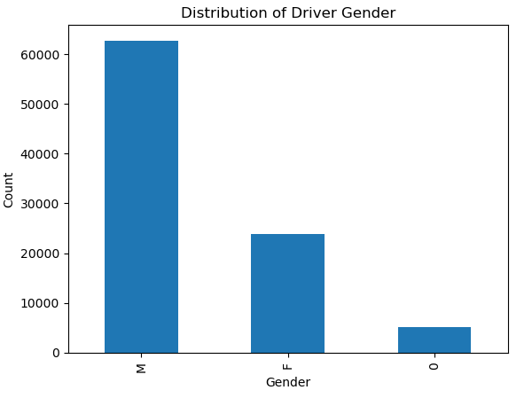
Data on Gender
91,742 total traffic violations
Men committed 62,762 violations (68.4%)
Women committed 23,774 violations (25.9%)
8.7% gender unknown/unspecified

Slide 5
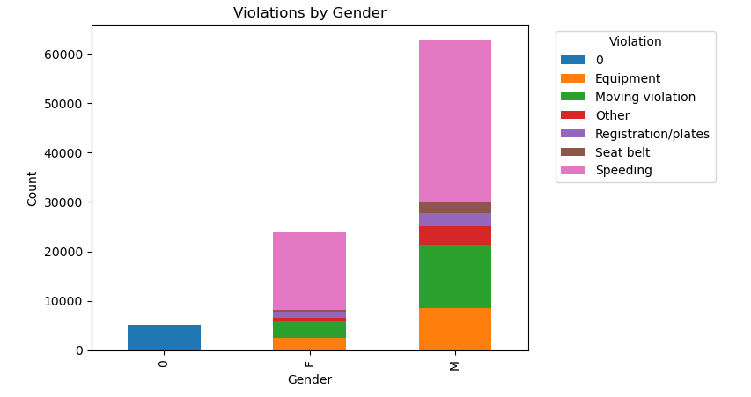
Traffic Violation by Gender
Violations were divided into seven categories
Each gender committed these violations to varying degrees
Information on offenders with unknown/unspecified gender were disregarded

Slide 6
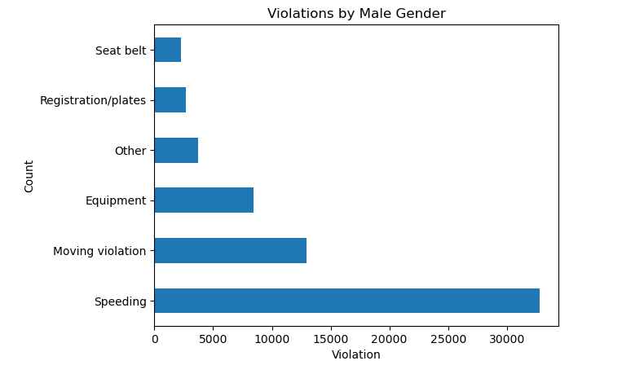
Male Traffic Violations
Males committed:
32,777 speeding violations (52.2%)
12,398 moving violations (20.6%)
8,240 equipment violations (13.1%)
2,647 registration/plate violations (4.12%)
2,278 seat belt violations (3.63%)
3,702 miscellaneous violations (7.35%)

Slide 7
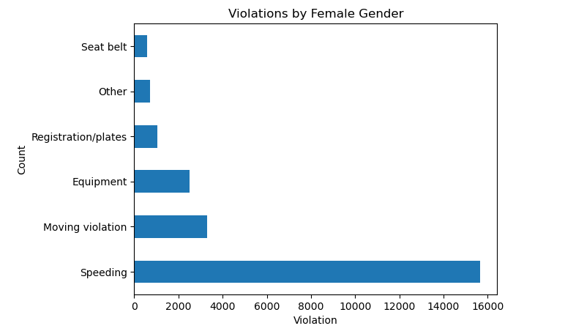
Female Traffic Violations
Females committed:
15,646 speeding violations (65.8%)
3,286 moving violations (13.8%)
2,501 equipment violations (10.5%)
1,056 registration/plate violations (4.44%)
578 seat belt violations (2.43%)
707 miscellaneous violations (2.97%)

Slide 8
Data Interpretation
Overall, males were over twice as likely to commit a traffic violation
68.4% vs. 25.9%
Comparing violations rate by gender, male to female
Speeding: 52.2% and 68.5%
Moving: 20.6% and 13.8%
Equipment: 13.1% and 10.5%
Registration: 4.12% and 4.44%
Seat belt: 3.63% and 2.43%
Misc.: 7.35% and 2.97%

Slide 9
Conclusion
There is a significant correlation in gender and traffic violations
While men commit more overall traffic violations, women violations themselves are not necessary gender specific

Slide 10
Thank you!
2023

